Slide 1

Employee Churn
Analysis

Slide 2
Introduction
Understanding why employees leave and identifying those at risk of leaving are crucial for maintaining organizational stability and productivity.
Employee churn analysis helps HR departments pinpoint the factors contributing to employee turnover and implement effective retention strategies.
This presentation outlines the approach taken to analyze employee churn, the insights gained, and the recommended actions to improve employee retention.

Slide 3
Problem Statement
Having Issues with Keeping Employees
Objective: Identify employees at risk of leaving the company.

Slide 4
Approach
Pilot Program with New Employees
Selected a pilot group of new employees to test the model.
Built an Auto ML model trained on historical data of past employees.
Model Selection
Compared various machine learning models.
Chose Random Forest, which achieved 93% accuracy on new data.

Slide 5
Workflow of ML model
Training
Testing
Prediction
Data Split: Train the model on 70% of existing employee data.
Model Validation: Test and tune the ML model on the remaining 30% to ensure accuracy.
Use the validated ML model to predict which employees are at risk of leaving.

Slide 6

Key Questions
What is causing employees to leave?
Who is predicted to leave (highest probability)?
Are employees satisfied?
What departments have the most churn?

Slide 7
Answers through insights
1. Reasons for Leaving
  Job satisfaction is the primary factor influencing employee departures.
  Key retention factors: tenure, number of projects handled, moderate working hours, and high performance evaluations.
  The occurrence of work accidents does not significantly impact the decision to stay or leave.
2. Predicted to Leave
  Employees in the management department are most likely to leave, followed by those in the support department.
3. Employee Satisfaction
  Employees in IT, product management, sales, accounting, HR, and marketing departments are satisfied, as no immediate churn is predicted from these departments.
4. Departments with Most Churn
  The highest churn rate is in the management department (20% predicted to leave).
  The support departmentt follows with 13% predicted to leave.

Slide 8
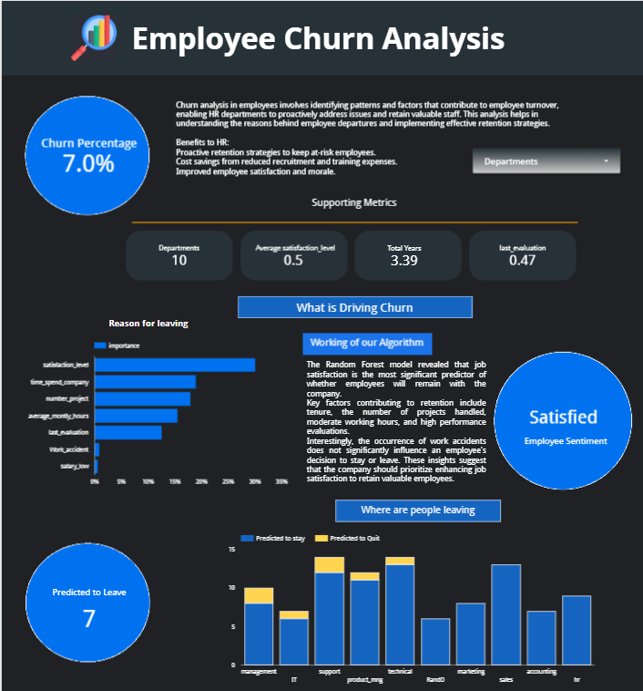
Looker Dashboard
https://lookerstudio.google.com/reporting/eaa55797-2ad1-4b05-b9a6-c79ea9c61a38

Slide 9
Conclusion and Recommendations
Enhancing Employee Retention
  Implement and enhance employee recognition programs to acknowledge and reward contributions.
  Focus on boosting job satisfaction through initiatives that address employee needs and concerns.
  Introduce professional development programs to foster growth and career advancement.
  Recognize and reward long-term employees to reinforce loyalty and commitment.

